Slide 1
Randomized, Double-blind Trial Of Olanzapine Versus Placebo In Patients Prodromal Symptomatic For Psychosis
Name
Institution
Professor
Date

Slide 2
About The Article
Title: Randomized, Double-Blind Trial of Olanzapine Versus Placebo in Patients Prodromally Symptomatic for Psychosis
Authors: Thomas H. McGlashan, M.D. Robert B. Zipursky, M.D. Diana Perkins, M.D. Jean Addington, Ph.D. Tandy Miller, Ph.D. Scott W. Woods, M.D. Keith A. Hawkins, Psy.D. Ralph E. Hoffman, M.D. Adrian Preda, M.D. Irvin Epstein, M.D., F.R.C.P.C. Donald Addington, M.D. Stacy Lindborg, Ph.D. Quynh Trzaskoma, M.S. Mauricio Tohen, M.D., Dr.P.H. Alan Breier, M.D.
Journal: Am J Psychiatry 2006; 163:790–799
Date of publication: Jan 20th 2006

Slide 3
About Schizophrenia
Prodromal refers to the initial signs and symptoms that a person develops before the actual defining and diagnostic signs and symptoms of a condition/illness.
Schizophrenia is a condition that affects close to one percent of the world population.
Its contribution to the morbidity and mortality especially in mental health has made the condition be of interest in the health systems.
It is therefore a psychiatric illness that is important in terms of its management and the current research concerning new developments aimed at its management and treatment.

Slide 4
The researchers hypothesize
The paper hypothesizes that olanzapine is efficient in both delaying and preventing psychosis which could result from conversion(McGlashan et al., 2006)
The paper also hypothesizes that olanzapine is efficient in reducing symptoms in individuals who have prodromal symptoms of schizophrenia
The title of the article is randomized, double-blind trial of olanzapine versus placebo in patients prodromal symptomatic for psychosis

Slide 5
The paper considers chronic schizophrenia
The paper is important because it analyzes the rationale for detecting chronic schizophrenia early for early appropriate interventions to be taken
The paper is further important because it traces the development of interventions for preventing schizophrenia including; the use of atypical antipsychotics (McGlashan et al., 2006)
The paper also looks into how it is possible to identify people at high risk psychosis in the early stages of schizophrenia
This identification is done with a high yet reasonable psychometric reliability, precision, and high predictive validity

Slide 6
We only know of three randomized studies
McGorry et al carried out a randomized clinical trial on patients who meet the criteria for high risk prodromal symptoms of schizophrenia. He revealed that early interventions were both efficient and safe
The second study was conducted by Morrison et al (McGlashan et al., 2006). He found out that using psychosocial treatment alone helped to both prevent and delay the start of schizophrenia
The third study is the current one presented by the authors in this article which assesses the efficiency of olanzapine in managing schizophrenia

Slide 7
Previous reports are key for this article’s rationale
In line with the studies that have already been done, this study looks at the impact of olanzapine in the year when the double-blind treatment was conducted as well as the following year when no treatment was offered.
The study analyzes three reports that were published before the current study. The analysis was conducted to understand the study rationale and design, the procedures for recruitment based on appropriate characteristics of prodromal individuals
The previous reports also helped in the assessment of the safety and efficiency of olanzapine as opposed to placebo during the first eight weeks of the period of double-blind (McGlashan et al., 2006)

Slide 8
Post-hoc and covariance are used in the article
The study used a post-hoc analysis of the cox proportional hazards model to handle right-censored observations, accounting for the events’ timing and the evaluation of the primary efficacy measures (McGlashan et al., 2006)
The score for prodromal positive symptoms is also used to define both psychosis and the conversion to psychosis
The analysis of covariance is also used to evaluate the changes in the efficacy of the study variables continually during the study period
Fisher’s exact test is also used in the study to understand demographic features and treatment-emergent extrapyramidal symptoms of the persons in the study

Slide 9
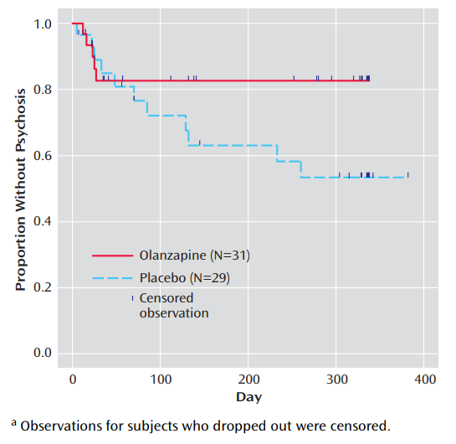
Result Figure 1

Slide 10
Olanzapine is better than placebo
The rate of family history for people in the study with nonpsychotic depression, was higher in the placebo group (McGlashan et al., 2006)
There was also no significance difference of compliance with the study drug between the two groups; the placebo and Olanzapine groups of participants
The rate of conversion to psychosis was higher for the placebo group than for the olanzapine group as much as the difference was not significant
The olanzapine group showed a significant improvement in the positive symptoms compared to the placebo group. The difference was almost significant

Slide 11
Olanzapine is effective
Olanzapine delays rather than prevents psychosis. 33.3% of the patients in the olanzapine group were affected by conversion and the symptoms were higher when the drug was stopped (McGlashan et al., 2006)
Olanzapine also reduces prodromal symptom severity. There were found significant differences in positive and prodromal symptoms between the placebo and the olanzapine groups
There was no significant difference in the rates of treatment-emergent extrapyramidal symptoms between the placebo and olanzapine groups

Slide 12
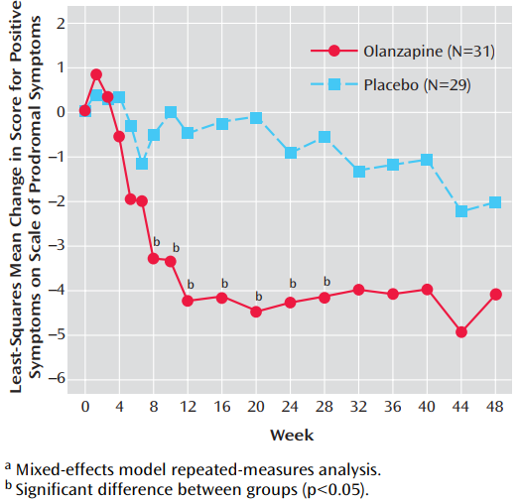
Result Figure 2

Slide 13
Treatment Effect
The mixed-effects model repeated-measures least-squares mean change in positive symptoms on the Scale of Prodromal Symptoms for the olanzapine and placebo groups at each post baseline visit during study period 2
overall treatment effect (F=5.21, df=1, 53, p<0.03) and the week-of-therapy effect (F=1.76, df=17, 555, p<0.03) indicated significant differences
Insignificant interaction of treatment and week of therapy (F=1.25, df=17, 555, p=0.22), indicating insignificant changes of the treatment over time.

Slide 14
Where did the researchers fail?
The study does not clearly explain why the olanzapine patients who experienced conversion to psychosis did so in the first four weeks of the treatment
Since the olanzapine group involved the most symptomatic patients, it would have been very informative if the researchers explained what predisposed them to conversion to psychosis as compared to less symptomatic patients
The researchers do not give a generalized finding informed by the analysis of the post hoc analysis and the cox proportional hazard model making it difficult for the readers to interpret the findings

Slide 15
The results confirmed the hypotheses
It is beneficial to identify the symptoms of psychosis while it is still on the onset stage. It is very important to treat psychosis while it is still in its early stages
Early identification and interventions help with the coming up of relevant recommendations regarding the use of antipsychotics to treat schizophrenia at its prodromal phase
Consistent with the first hypothesis, olanzapine is efficient in delaying conversion to psychosis (McGlashan et al., 2006)
The results revealed olanzapine does reduce symptoms in persons with prodromal schizophrenic symptoms consistent with the second hypothesis

Slide 16
Note better!!!
Olanzapine is effective in;
1. delaying conversion to psychosis and,
2. reducing symptoms in persons with prodromal schizophrenic symptoms

Slide 17
Reference
McGlashan, T.H., Zipursky, R.B., Perkins,D., Addington,J., Miller, T.,Woods, S.W., … & Addington, D. (2006). Randomized, double-blind trial of olanzapine versus placebo in patients prodromally symptomatic for psychosis. American Journal of Psychiatry, 163(5), 790-799

Slide 18
Thank you!!!!!!
Any question??

